Slide 1
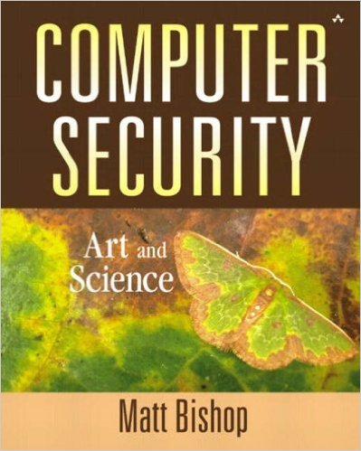
Computer and Network Security COMP 5370/637* Lecture #13 September 16, 2015
Tony Skjellum
skjellum@auburn.edu

Slide 2
Today’s Topics
Authentication

Slide 3
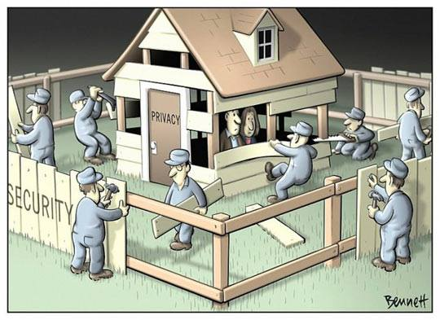
Security vs. Privacy

Slide 4
Basics
Authentication: binding of identity to subject
Identity = external entity (e.g., user, client)
What entity knows
What entity has
What entity is
Where entity is
Subject = computer entity (e.g., process, hardware)

Slide 5
Authentication System
Five components: <A, C, F, L, S>
A: information that proves identity
C: complementary information stored on computer and used to validate authentication information
F: complementation function; f : A → C
L: functions that prove identity
S: functions enabling entity to create, alter information in A or C
Example:
← password
← hash
←hashing functions
← comparison
← passwd

Slide 6
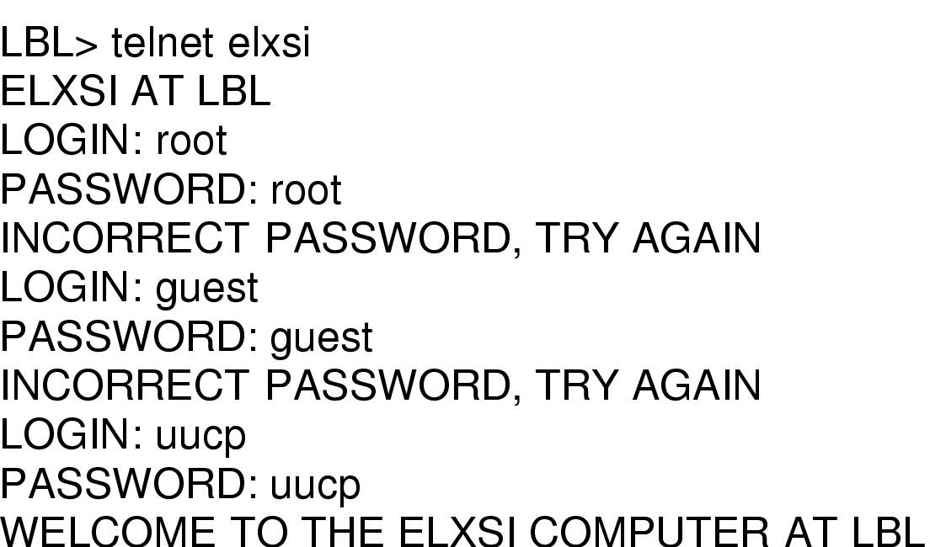
Passwords in use … not
How a cracker broke into Lawrence Berkeley National Lab, a US DOE research lab
http://paolodelbene.pbworks.com/w/file/fetch/70361504/cuckoo_s_egg.pdf
Notes:
Uucp is the account for Unix to Unix copying. That is, it is for one computer to copy a file to another. It is not intended to be used by humans, and this action should be disabled. Not only was the account enabled, but it suffered from a very weak password. The account also had root privileges. The hacker added himself as a user by editing the password file and began attacking the system as a register user.
http://paolodelbene.pbworks.com/w/file/fetch/70361504/cuckoo_s_egg.pdf

Slide 7
Most Common: Passwords
Sequence of characters
user generated vs system generated
considerations:
length
required characters
allowable characters
Sequence of words
pass-phrases
personal information
considerations:
privacy
security
Algorithms
one-time passwords
challenge-response
considerations:
complexity
convenience

Slide 8
Anderson's Formula for Length
Formulation
P probability of guessing a password in specified period of time
G number of guesses tested in 1 time unit
T number of time units
N number of possible passwords (|A|)
Then P ≥ TG/N
Example
Passwords drawn from a 96-char alphabet
Can test 10⁴ guesses per second
Probability of a success to be 0.5 over a 365 day period
N ≥ TG/P = (365×24×60×60)×10⁴/0.5 = 6.31×10¹¹
Choose s such that Σ^{s}_{j=0} 96^{j} ≥ N
So s ≥ 6, meaning passwords must have at least 6 chars

Slide 9
Password Selection
Random Selection – the time needed to guess a password is at a maximum when all passwords are equiprobable
Quality of generation algorithm – what is size of password space? How many seed values?
Human factors
random passwords are hard to remember
users often write down the password
solution – write down a transformation
Eg if password is “aWX3s” write down “a2WEXp36s”
Transformation is to take every other letter
Password aging – how often should a password be changed?
Notes:
(new slide)

Slide 10
Pronounceable Passwords
Compromise between random passwords and written-down passwords
Based on phonemes – units of sound
Easier to remember
Examples: “helgoret” and “juttelon”
there are more phonemes than characters
Password with 96 random characters has up to 7 x 10¹⁵ possibilities
If there are 440 possible phonemes, generating passwords with up to six phonemes has approximately the same number of possibilities.
Notes:
(new slide)

Slide 11
User Selection of Passwords
Users may be allowed to select their own passwords. Often they are subject to restrictions, such as prohibition on
variation on account name
variation on user name
dictionary words (forward, reversed, vowels removed)
keyboard patterns
past passwords
Notes:
(new slide)
Table presents results of Klein’s password guessing experiments, as summarized in the text. 15,000 potential passwords from 50 different websites. http://cs.gmu.edu/~csnow/library/unix/Klein_passwd.pdf

Slide 12
Most Common Passwords 2013
123456
password
12345678
qwerty
abc123
123456789
111111
iloveyou
adobe123
123123
admin
letmein
photoshop
1234
shadow
sunshine
12345
password1
princess
azerty
trustno1
000000
monkey1234
http://www.cbsnews.com/news/the-25-most-common-passwords-of-2013/
Notes:
(new slide)
http://www.cbsnews.com/news/the-25-most-common-passwords-of-2013/

Slide 13
Preventing Attacks
Backoff – after each failed login attempt, the user must wait an increasing amount of time to try again
Disconnection – after a certain number of failed attempts, the connection is broken and the user must reestablish it
Disabling – after a certain number of failed authentication attempts, the account is disabled until a security manager can re-enable it
Jailing – attacker is given limited access and made to believe he has full access. His actions are recorded
Notes:
(new slide)

Slide 14
Password Guidance – The Green Book
DOD Password Management Guideline, 12 Apr 85
Password Vulnerabilities
a password must be initially assigned to a user when enrolled on the ADP system;
a user's password must be changed periodically;
the ADP system must maintain a "password database";
users must remember their passwords; and
users must enter their passwords into the ADP system at authentication time.
Green Book Guidelines
Users should be able to change their own passwords.
Passwords should be machine-generated rather than user-created.
Certain audit reports (e.g., date and time of last login) should be provided by the system directly to the user.

Slide 15
Protecting Passwords – Green Book
Use of Access Control Mechanisms
Use of Encryption
Transmission
Login Attempt Rate
Audit Trails
Real-time Notification to System Personnel
Recommended 5 or more unsuccessful attempts
Notification to the User
Upon successful login, the user should be notified of:
The date and time of user's last login;
The location of the user (as can best be determined) at login; and
Each unsuccessful login attempt to this user ID since the last successful login.

Slide 16
Intrusion Techniques (passwords)
Techniques for guessing passwords:
Try default passwords.
Try all short words, 1 to 3 characters long.
Try all the words in an electronic dictionary(60,000).
Collect information about the user’s hobbies, family names, birthday, etc.
Try user’s phone number, social security number, street address, etc.
Try all license plate numbers (MUP103).
Use a Trojan horse
Tap the line between a remote user and the host system.
Prevention: Enforce good password selection (Ij4Gf4Se%f#) – Stallings’ recommendation!

Slide 17
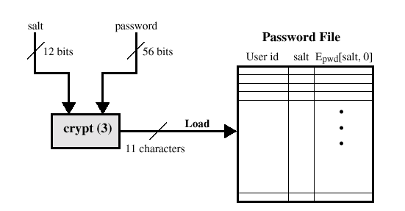
UNIX Password Scheme
Notes:
Passwords not stored in plain text. One of 4096 functions hashes the password into an 11-character string, and two characters are prepended identifying the function. The 13 character string is stored in a file. Passwords are up to 8 characters, each chosen from a set of 127.

Slide 18
UNIX Password Scheme, 2
CAPTIONS PREVIOUS SLIDE:
Loading password
Passwords not stored in plain text.
One of 4096 functions hashes the password into an 11-character string, and two characters are prepended identifying the function.
The 13 character string is stored in a file.
Passwords are up to 8 characters, each chosen from a set of 127.
Notes:
Passwords not stored in plain text. One of 4096 functions hashes the password into an 11-character string, and two characters are prepended identifying the function. The 13 character string is stored in a file. Passwords are up to 8 characters, each chosen from a set of 127.

Slide 19
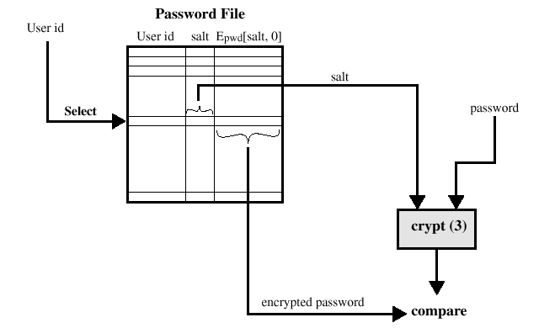
UNIX Password Scheme, 3

Slide 20
UNIX Password Scheme, 4
CAPTIONS PREVIOUS SLIDE:
Verifying password
User id points to hash and salt
Salt added to password, entire item is hashed
Compare hash to stored hash

Slide 21
Storing UNIX Passwords
UNIX passwords were kept in in a publicly readable file, etc/passwords.
Now they are kept in a “shadow” directory and only visible by “root.”
A "salt" (n-bit random number) is added to
Prevents duplicate passwords.
Effectively increases the length of the password.
Twarts the use of hardware implementations of DES

Slide 22
Windows 2000 Passwords
LM
an encrypted, fixed, hex value
NT Password Hash
3 rounds of MD4 hashing algorithm
User Mode Security Subsystem
Kernel Mode Security Ref. Monitor
Security Accounts Manager
SAM Database
Checks user and program permissions before allowing access to objects
Defines how audit settings translate into the actual capture of events by the Event Log
2 password entries for each account.
Format: ID:LM representation :NT Hash

Slide 23
LM (LanManager) Passwords
Adjust password length to 14 characters by either truncation or padding.
Divide string into 2 parts, add one bit of parity to each part.
Parity required for using DES
Each part used as a key for DES encryption of a hexadecimal number
Splitting the string into two parts allows an attacker to attack each half independently
LM representation is neither a hash nor an encrypted password, it is an encrypted, fixed hex number is which the password is used as the key.

Slide 24
NT Password Representation
Adjust password length to 14 characters
Use MD-4 hashing algorithm three times to produce a hash of the password.
NT Password is not salted
NT password cracking programs only need to access a dictionary.

Slide 25
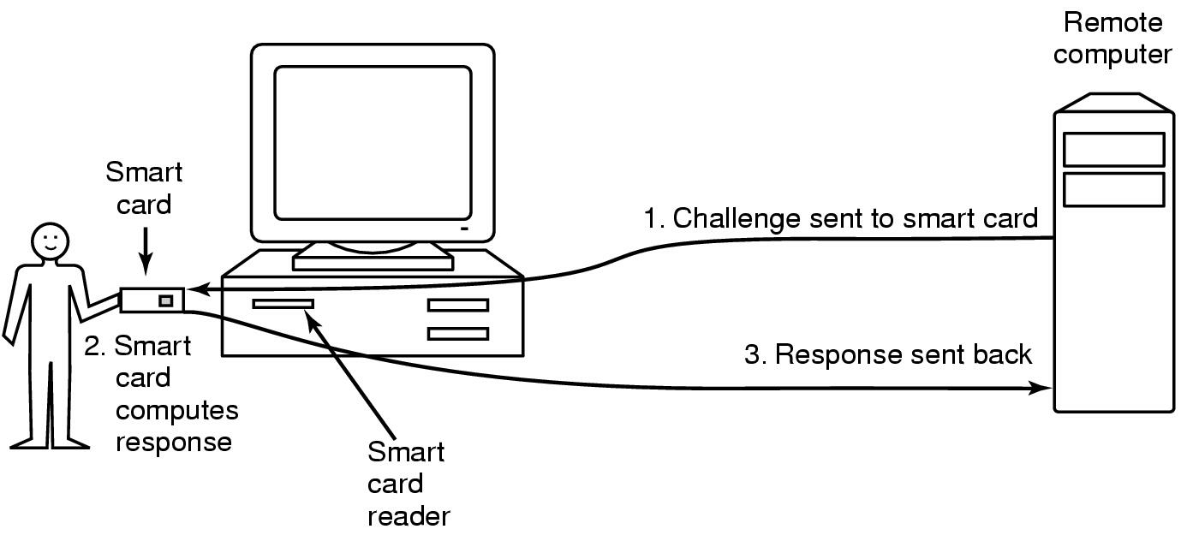
Authentication Using an Ownership
Magnetic cards
magnetic stripe cards
chip cards: stored value cards, smart cards
Notes:
Loss of object means that all mechanisms must be updated (eg lost key, change locks)

Slide 26
Biometric-based Authentication
Automated measurement of biological, behavioral features that identify a person
Fingerprints: optical or electrical techniques
Maps fingerprint into a graph, then compares with database
Measurements imprecise, so approximate matching algorithms used
Voices: speaker verification or recognition
Verification: uses statistical techniques to test hypothesis that speaker is who is claimed (speaker dependent)
Recognition: checks content of answers (speaker independent)
Eyes: patterns in irises unique
Measure patterns, determine if differences are random; or correlate images using statistical tests
Faces: image, or specific characteristics like distance from nose to chin
Lighting, view of face, other noise can hinder this
Keystroke dynamics: believed to be unique
Keystroke intervals, pressure, duration of stroke, where key is struck
Statistical tests used

Slide 27
Location Based Authentication
Takes location into account when a user authenticates
e.g., Suppose an employee is known to be working in California. If someone attempt to login to her account in New York, it is reasonable to believe that this is an attack.
Notes:
(new slide)

Slide 28
Key Points
Authentication is not cryptography
You have to consider system components
Passwords are here to stay … at least for a while longer
They provide a basis for most forms of authentication
Protocols are important
Selection leads to a more secure choice of authentication
Storing information properly contributes to security chain
Discussing multiple factor authentication--- separate discussion!

Slide 29
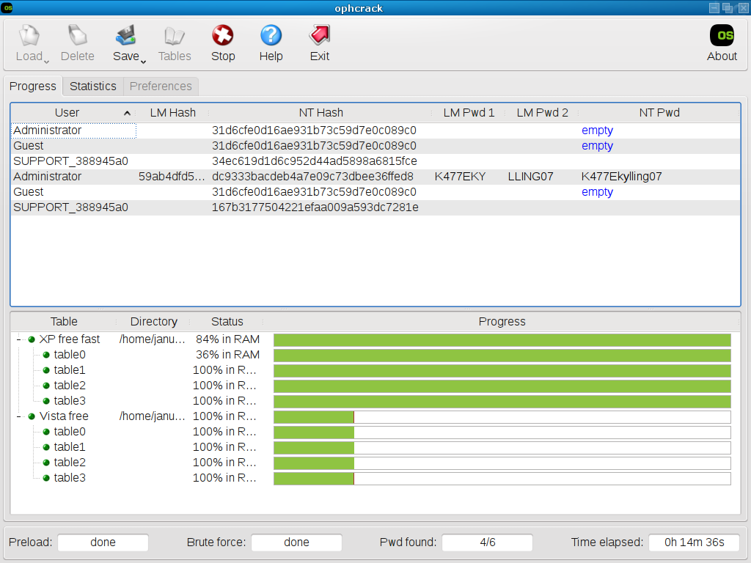

Slide 30
Example: Ophcrack
LM hash
855c3697d9979e78ac404c4ba2c66533
Ophcrack
http://www.objectif-securite.ch/en/ophcrack.php
Administrator:500:NO PASSWORD*********************:NO PASSWORD*********************:::
Guest:501:NO PASSWORD*********************:NO PASSWORD*********************:::
JoeTest:1001:NO PASSWORD*********************:E5810F3C99AE2ABB2232ED8458A61309:::

Slide 31
Unix Passwords Redux
Password Salt Encrypted Password
nutmeg Mi MiqkFWCm1fNJI
ellen1 ri ri79KNd7V6.Sk
Sharon ./ ./2aN7ysff3qM
norahs am amfIADT2iqjAf
norahs 7a 7azfT5tIdyh0I
Unix documentation:
[W]hat is stored in the /etc/passwd file is not really the encrypted password. … [It is] "the superencrypted block of zeros that is used to verify the user's password"

Slide 32
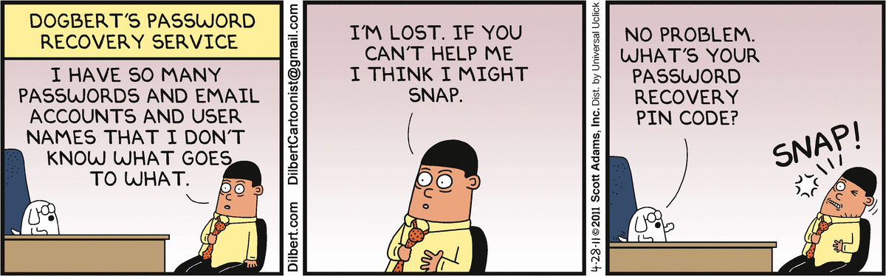
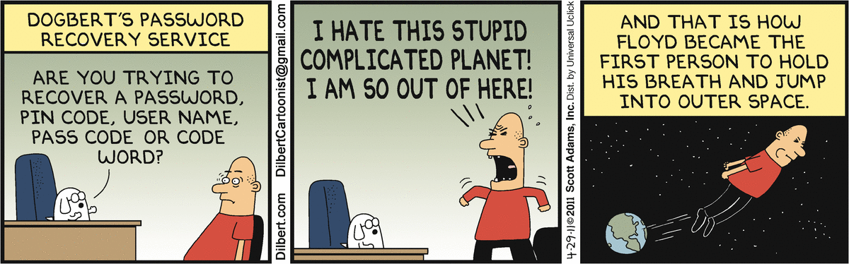
Final thoughts for today
http://dilbert.com/search_results?terms=Password

Slide 33
BACKUP

